Slide 1
MATHEMATICS
CALCULUS

Slide 2
Application of Definite Integration - Area

Slide 3
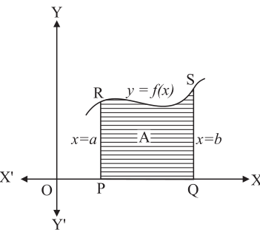
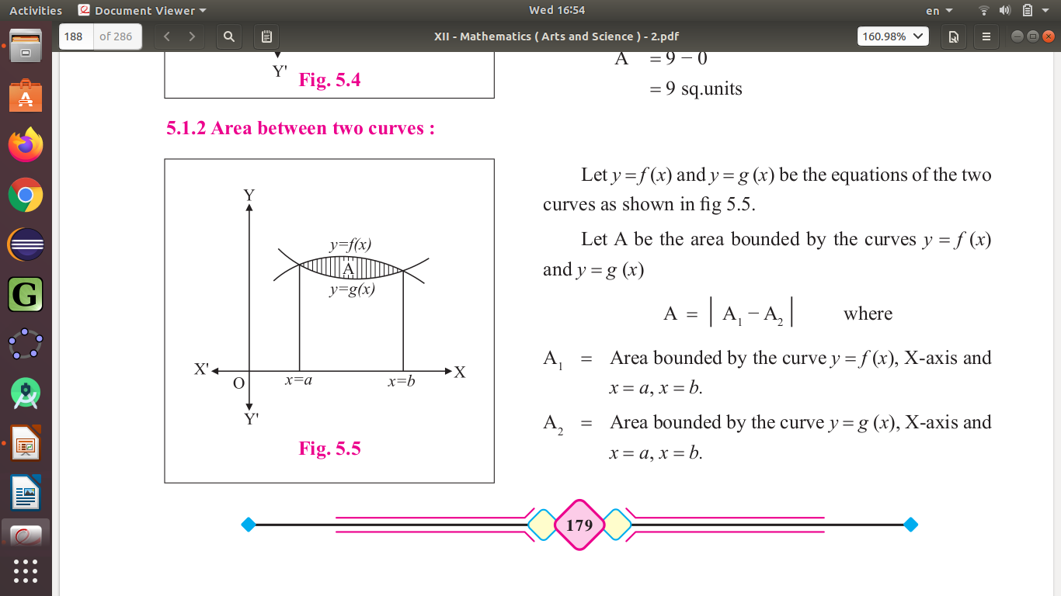
Application of Definite Integration - Area

Slide 4
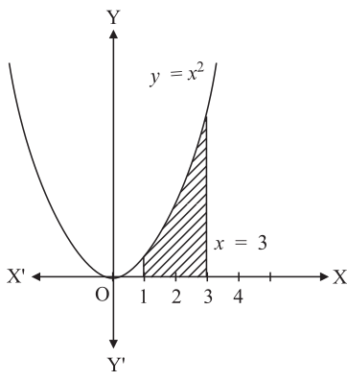
Examples

Slide 5
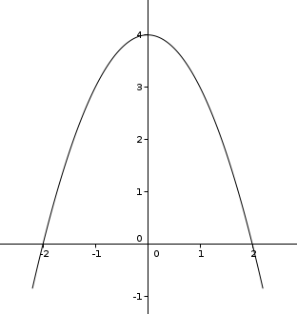

Slide 6
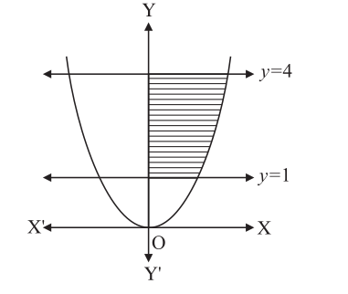

Slide 7
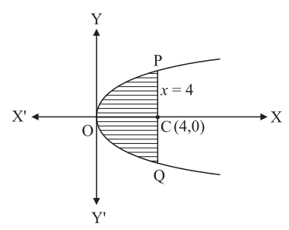

Slide 8
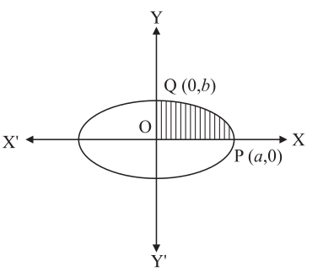

Slide 10
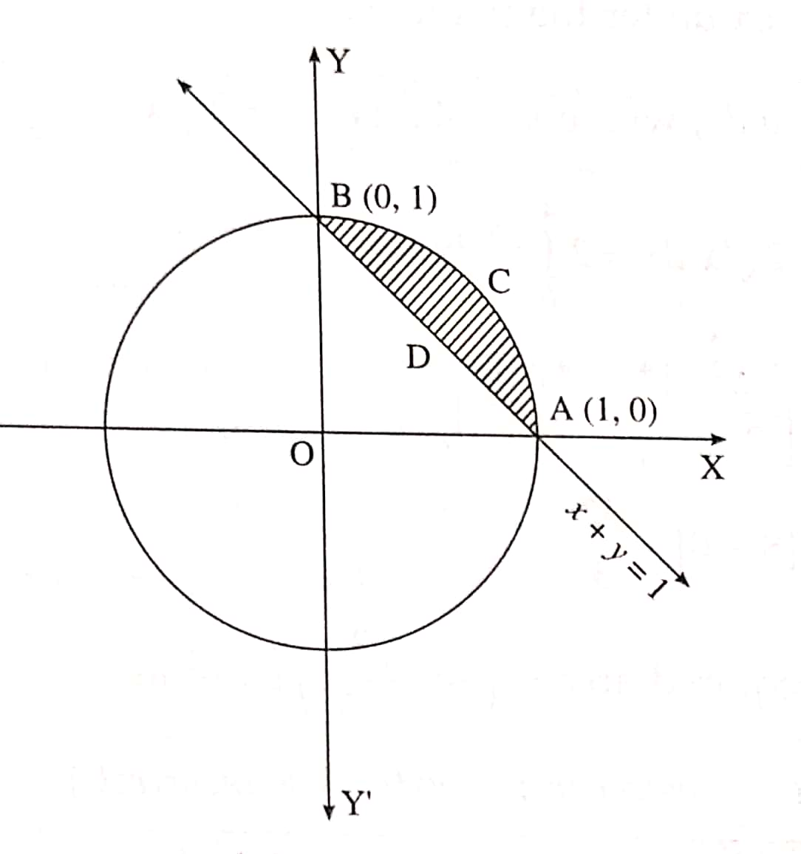

Slide 12
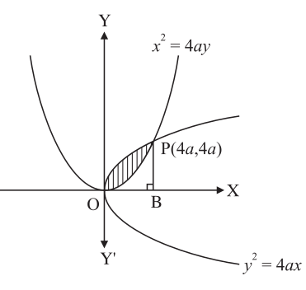

Slide 14
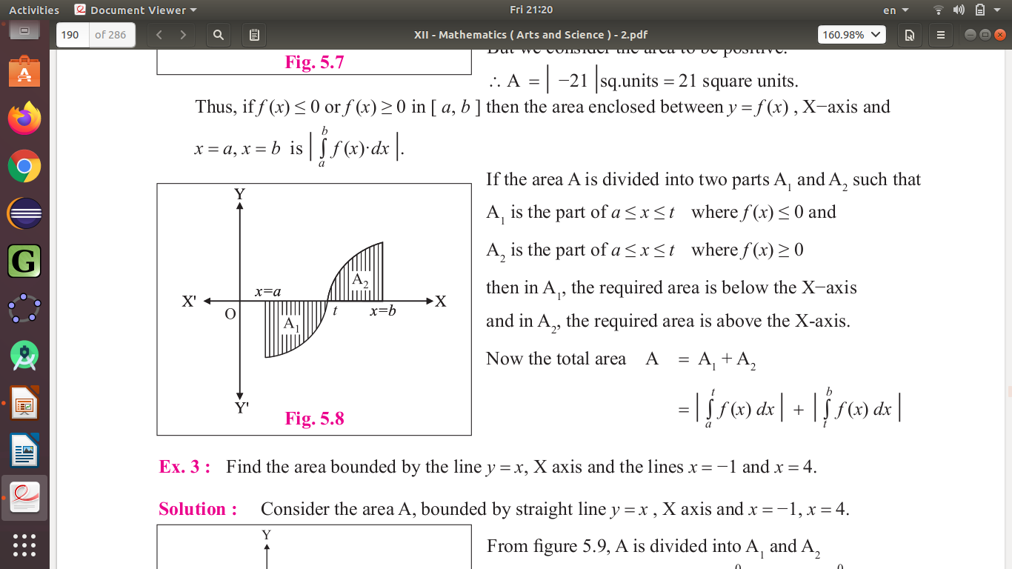

Slide 15
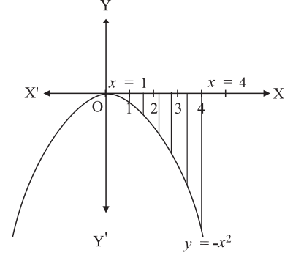

Slide 16
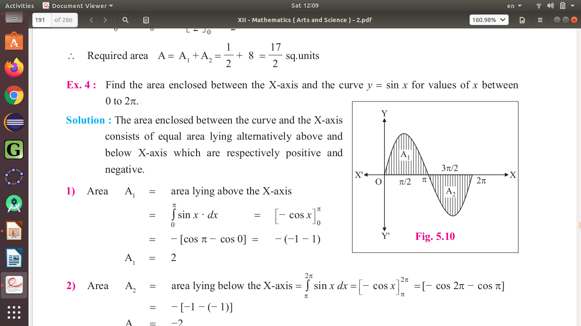

Slide 17
##### DONE #####

Slide 18
T H A N K Y O U

Slide 19
This is a presentation in
LI BREOFFICE – IMPRESS
By
Mr. Prahlad Chippalagtti.

